Slide 1
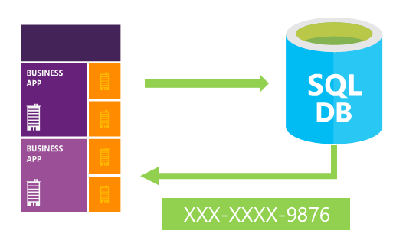

Dynamic Data Masking
Jean-Pierre(JP) Voogt
Twitter: @JPVoogt
jvoogt1@outlook.com

Slide 2
Overview
New feature introduced in SQL Server 2016 and in Azure SQL Database V12
Prevents non-privileged users to view sensitive data
Minimal changes to the application tier

Slide 3
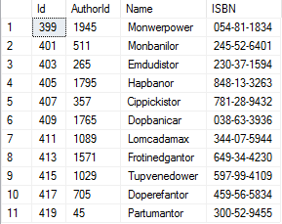
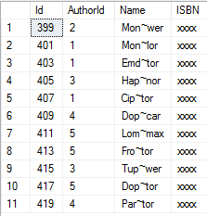
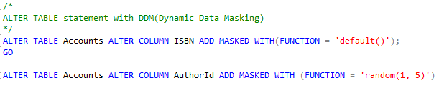
Example

Slide 4
Supported datatypes
Type | Data Type
String Data | char, nchar, varchar, nvarchar, text
Numeric Data | Bigint, bit, decimal, int, money, numeric, smallint, smallmoney, tinyint, float, real
Date Data | Date, datetime, datetime2, datetimeoffset, smalldatetime, time
Binary Data | Binary, varbinary, image

Slide 5

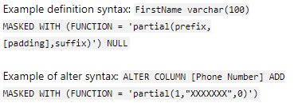
Functions
Function | Example Data | Masked Data
Default() | AdventureWorks | XXXX
Email() | jvoogt1@outlook.com | jXXX@XXXX.com
Custom* | AdventureWorks | AXXXXs
Random()* | 123456 | 25
*Has extra parameters to configure
https://docs.microsoft.com/en-us/sql/relational-databases/security/dynamic-data-masking?view=sql-server-2017

Slide 6
Nice to know
Users that cannot see the masked data, can still update the data
INSERT INTO and SELECT INTO will create the masked data in its masked form on the Target table
Backups made by users without the permissions to see the masked data, will result in the backup containing the masked data in a statics masked form
Cannot be setup on a calculated column
Cannot be used in a fulltext index
Can be created on an existing column and dropped without data loss

Slide 7
Permissions
Function | Permission
Creating/Altering Tables | CREATE TABLE and ALTER on schema
Adding/ Removing Mask | ALTER ANY MASK
Viewing Data | UNMASK

Slide 8
References
MSDN - https://msdn.microsoft.com/en-us/library/mt130841.aspx
AZURE Getting Started - https://azure.microsoft.com/en-us/documentation/articles/sql-database-dynamic-data-masking-get-started/
CodeProject - http://www.codeproject.com/Articles/1084808/Dynamic-Data-Masking-in-SQL-Server
Database Journal - http://www.databasejournal.com/features/mssql/exploring-sql-server-2016-dynamic-data-masking-part-one-creating-a-table-that-uses-dynamic-data-masking.html

